Slide 1

INVESTIGACIÓN DE OPERACIONES (OPERATIONS RESEARCH)
Dr. Alejandro Rosete
Alejandro.Rosete.Suarez@gmail.com

Slide 2
General information

Slide 3
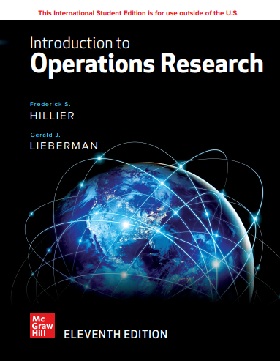
Basic book
Introduction to Operations research,
Eleventh Edition,
Frederick S. Hillier, Stanford university
Gerald J. Lieberman, Stanford university
2021,
McGraw-Hill

Slide 4
Style of the course
Presentations … introduction
Seminars … application, development
Groups?

